Slide 1
Scraping Web Skytrax and Collect Customer Feedback
Presented by Dinar Wahyu Rahman

Slide 2
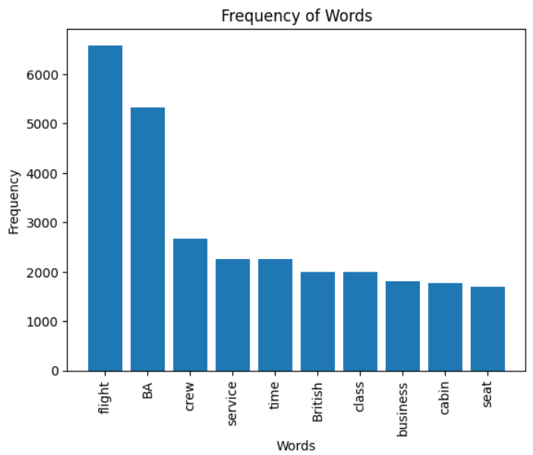
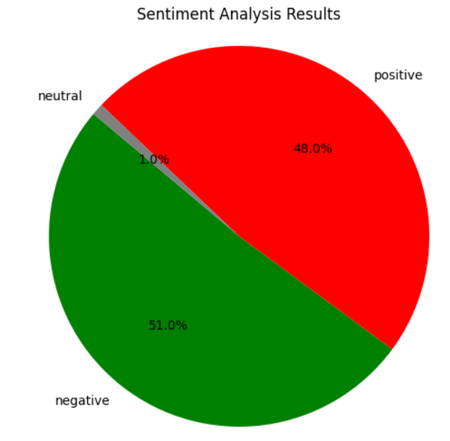
Result
Key Topics
The frequency graph below shows that the main topics in reviews include “flight”, “BA”, “crew”, and “service”, indicating that people are actively talking about their experience and staff.
Sentiment
From the pie chart above, positive sentiment gets 48.0%, negative 51.0%, and neutral 1.0%. 3700 reviews were taken, 1887 were negative, 1776 were positive, and 37 were neutral. This means most reviews are polarized into positive or negative.
48%
Positif
51%
Negatif
1%
Neutral

Slide 3
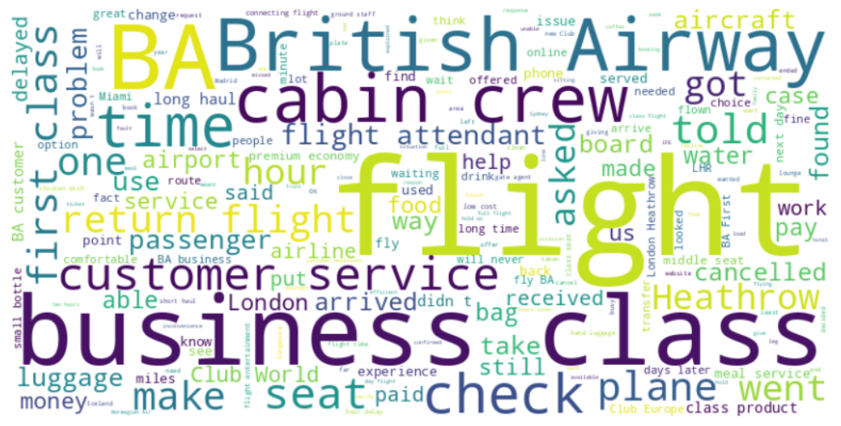
Insight WordCloud
The word cloud also showed similar words and key topics within the reviews. This includes “flight”, “BA”, "British Airway", “business class” and “time”, showing that people are actively talking about their experience and staff

